Slide 1
Test
Test

Slide 2
Here is a test
The NASA Planetary Defense Coordination Office (PDCO) was established in 2016 to study the mitigation of potential Near-Earth Object (NEO) impacts to our home planet. NASA Goddard and the National Nuclear Security Administration (NNSA) established a collaboration to study the short time response options to potentially hazardous objects (PHOS). The objectives of these study efforts motivated us to design this architectural framework (gateway) to provide unique capabilities to the Planetary Defense community including:

Slide 3
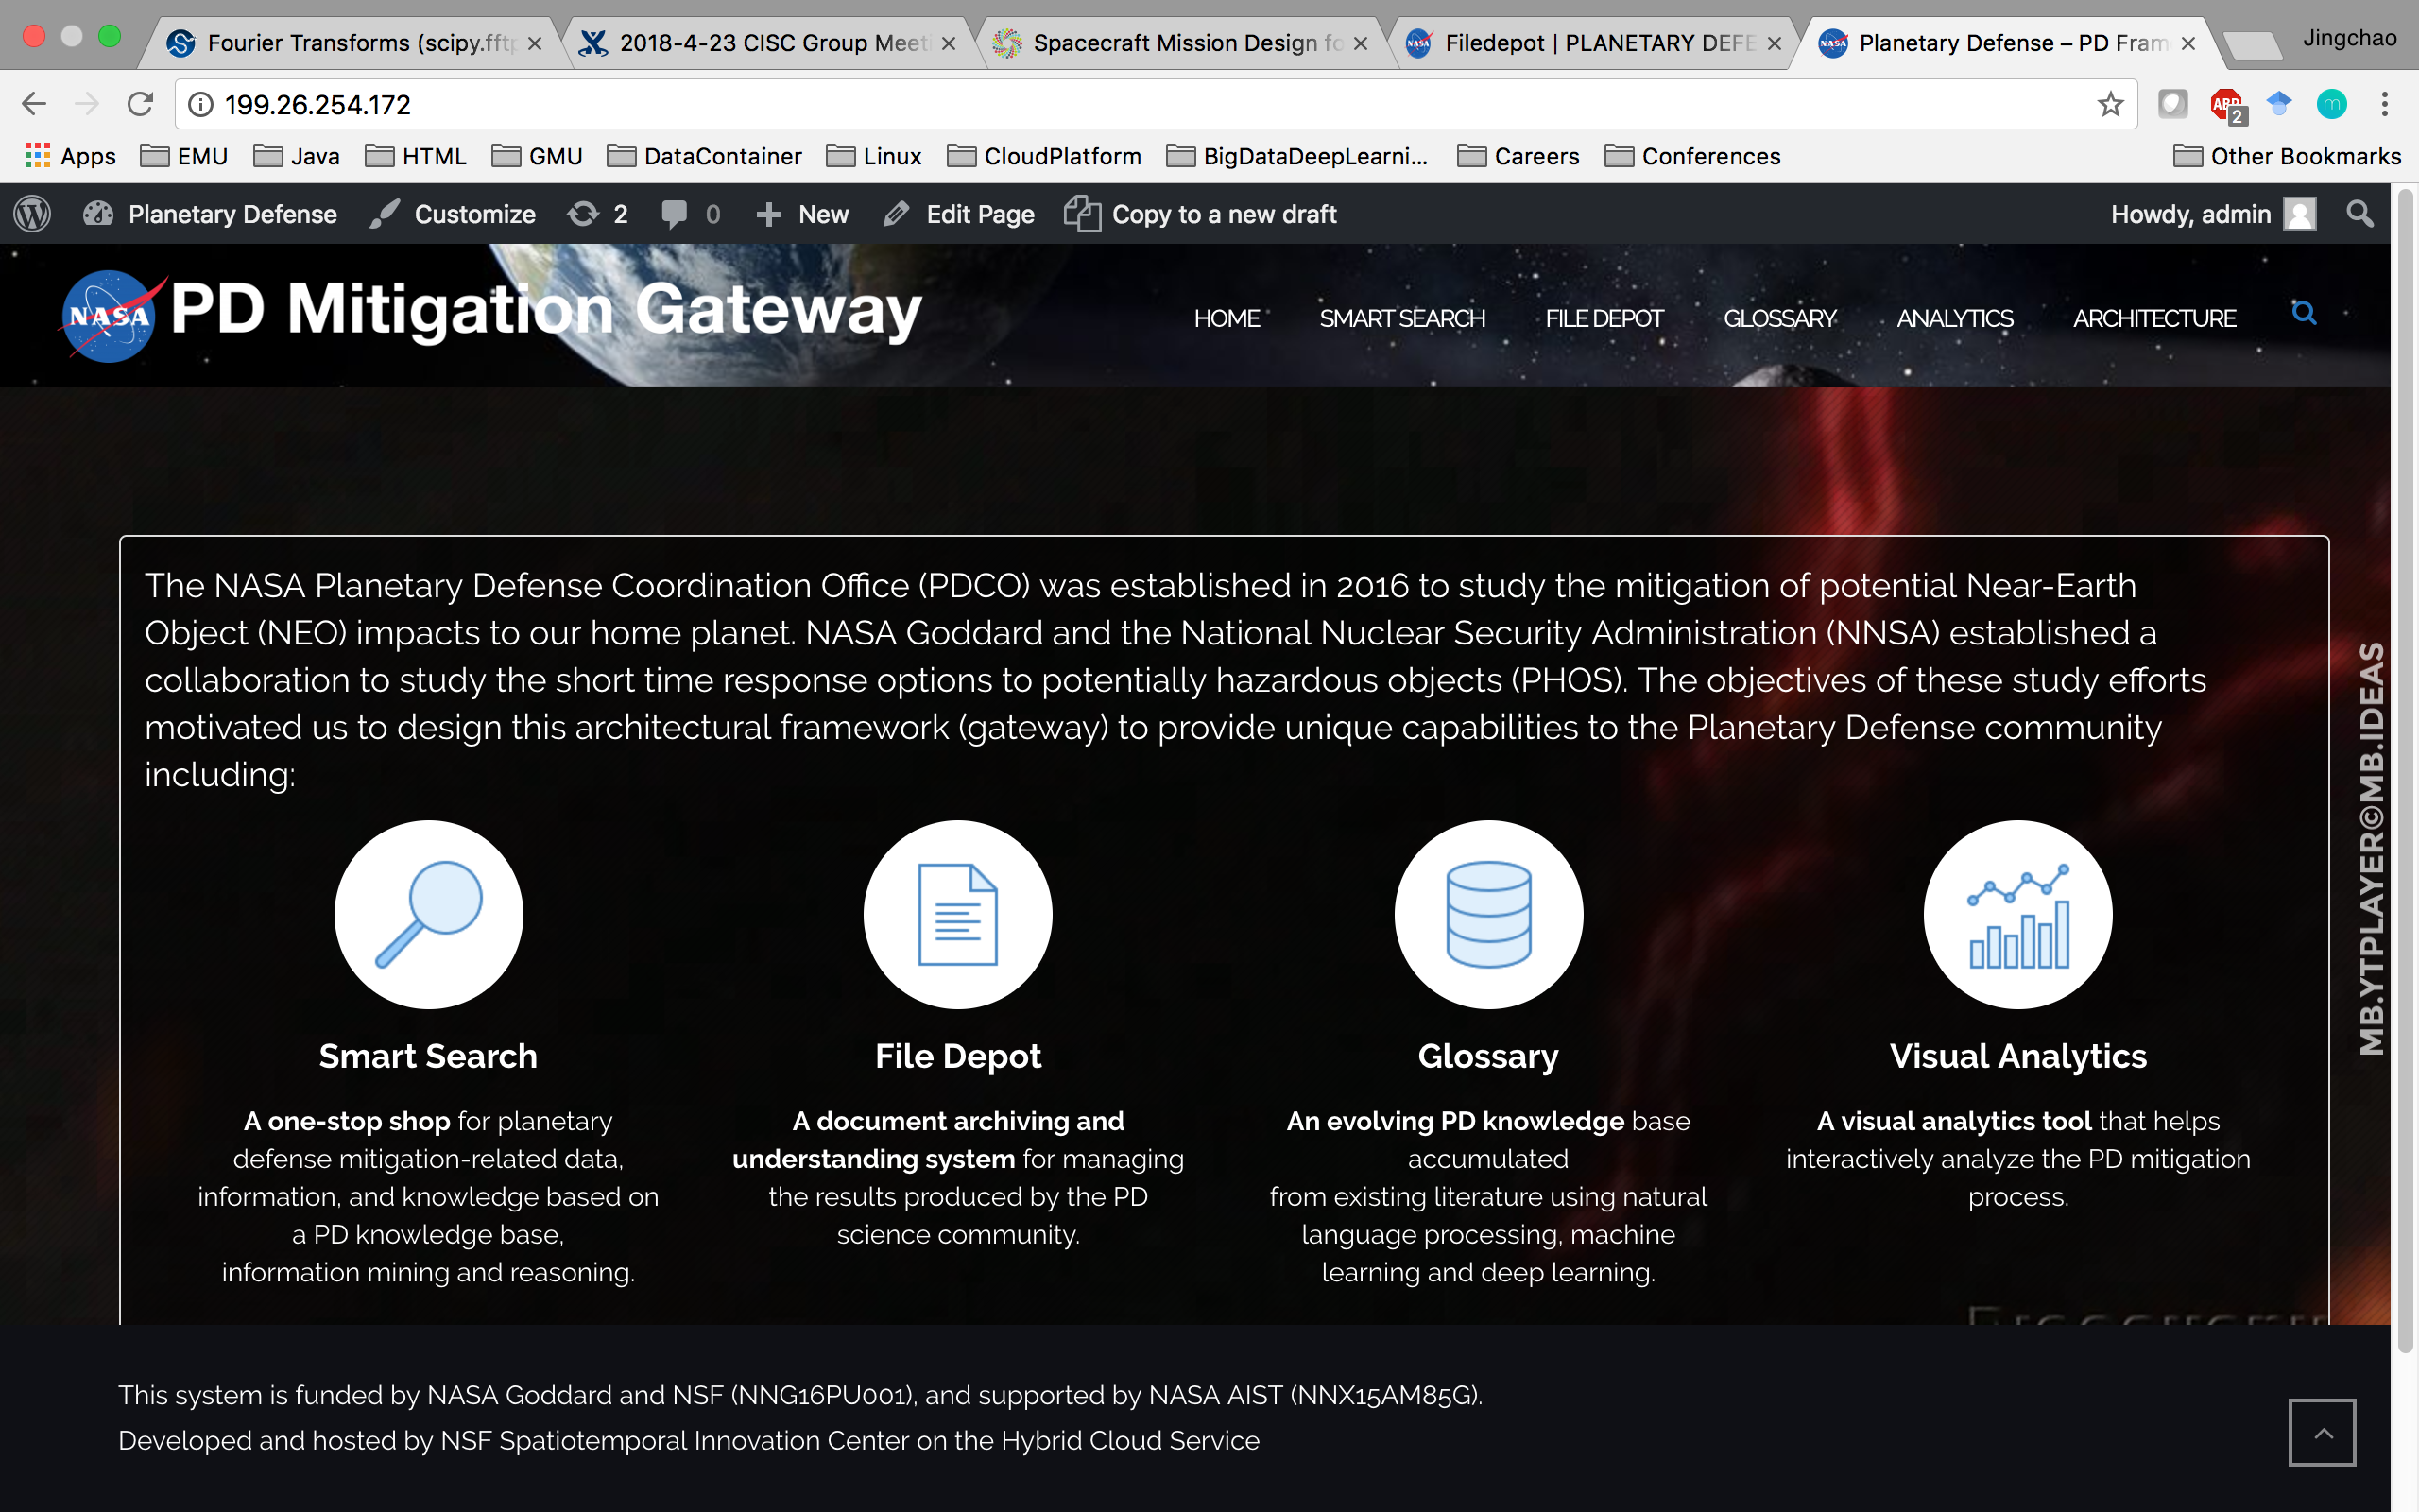
Here is a test

Slide 4
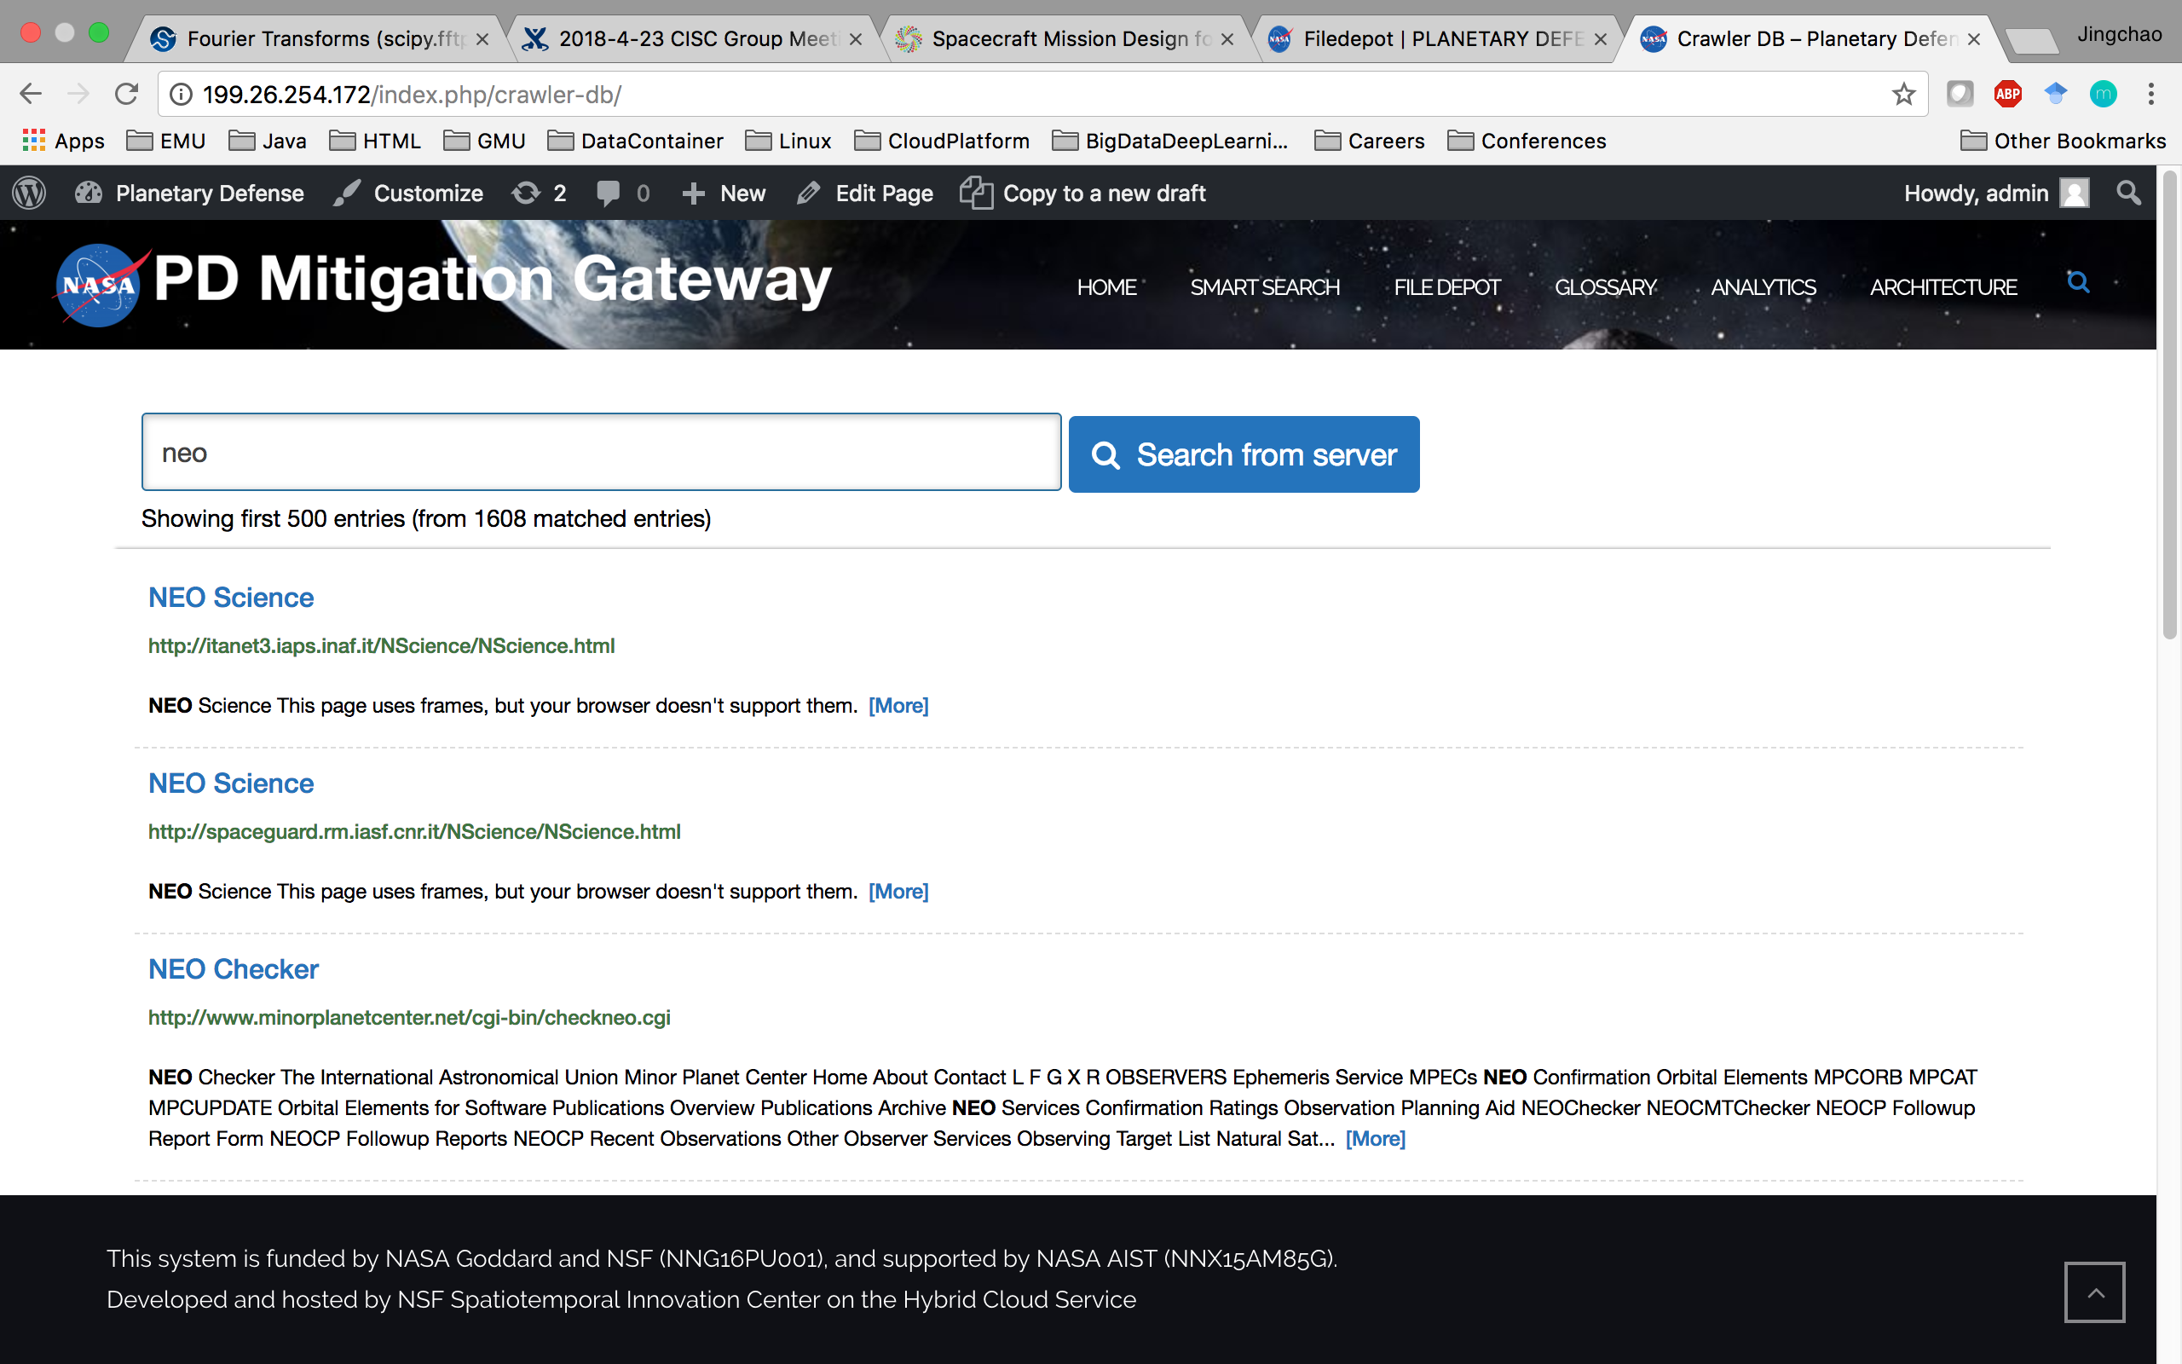
Here is a test

Slide 5
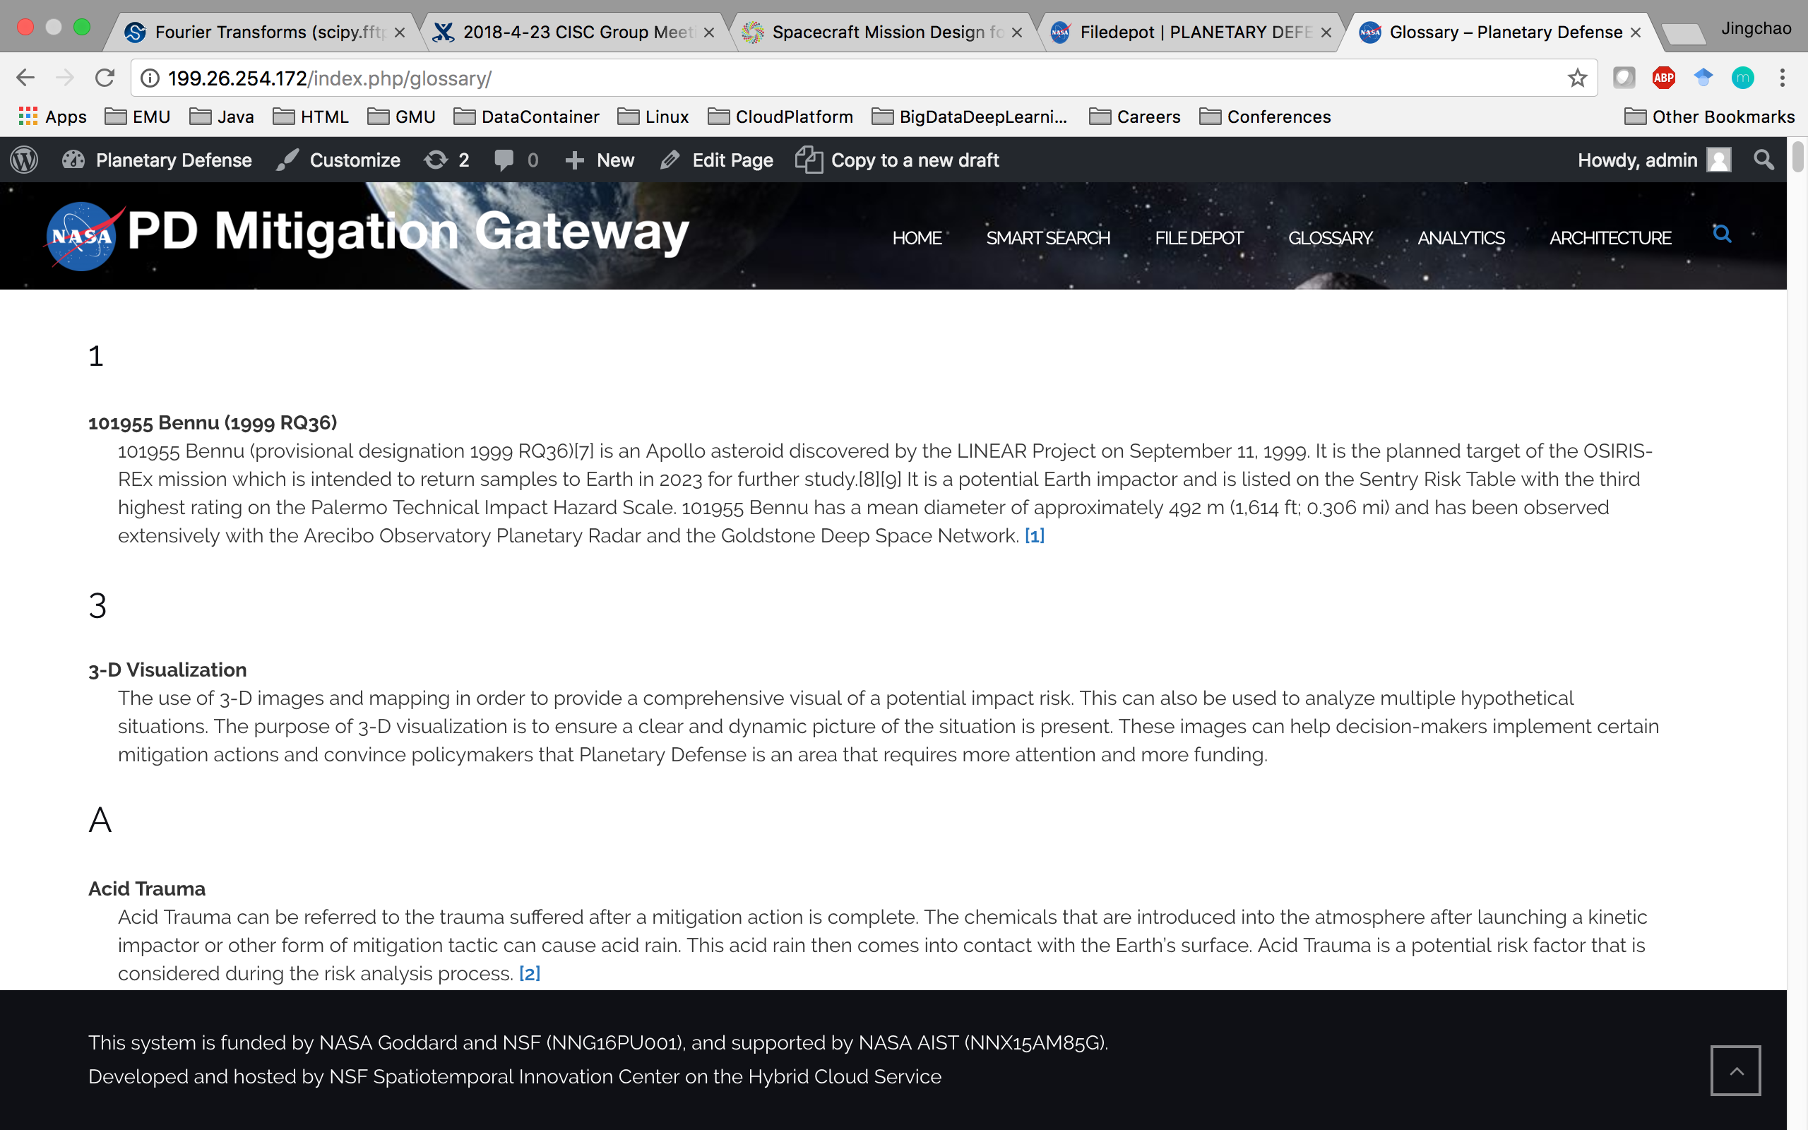
Here is a test

Slide 6
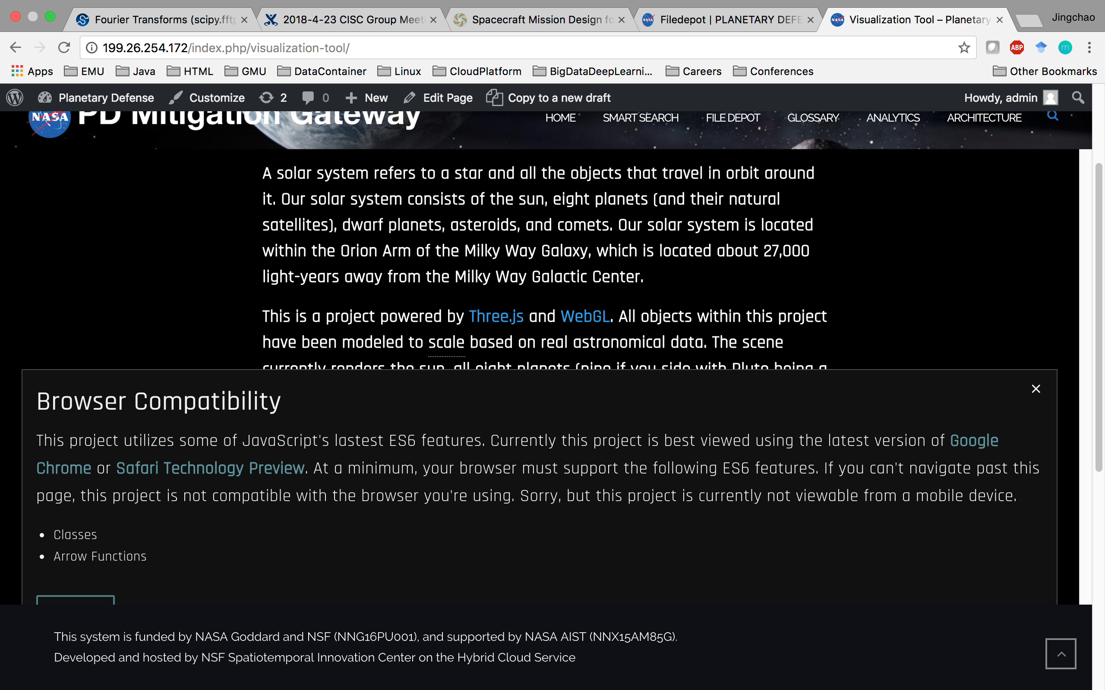
Here is a test

